Slide 1

Automated identification of vehicle using deep learning neural network
SRM INSTITUTE OF SCIENCE AND TECHNOLOGY
SCHOOL OF COMPUTING
DEPARTMENT OF COMPUTING TECHNOLOGIES
18CSP109L - MAJOR PROJECT
Guide name: Mrs. M VIJAYALAKSHMI
Designation: ASSISTANT PROFESSOR Department: COMPUTING TECHNOLOGIES
Batch ID: 240
Student 1 :
Reg.No: RA1911003010827
Name: S SRIRAMA KUMARA SWAMY
Student 2 :
Reg. No : RA1911003010840
Name : V.G. HARIKIRAN

Slide 2
ABSTRACT
This project proposes an automated identification system for vehicles using deep-learning neural networks. The system is designed to accurately recognize and classify vehicles based on their make and model using images captured by cameras placed in strategic locations. The proposed model employs a Recurrent neural network architecture, which has demonstrated outstanding performance in various image recognition tasks. The proposed system's performance is evaluated using a real-world dataset comprising images of diverse vehicles, and the results demonstrate that the proposed model achieves high accuracy in vehicle recognition. This project's contribution is a fully automated system for vehicle identification, which can be employed in various settings, including parking lots, toll booths, and traffic management systems. The proposed system's accuracy and efficiency can significantly enhance vehicle identification and tracking, leading to improved traffic management and increased security.

Slide 3
INTRODUCTION
Automated identification of vehicles is an essential task in modern transportation systems, as it enables various applications such as toll collection, and traffic monitoring. However, traditional methods for vehicle identification, such as manual inspection or radio frequency identification (RFID) tags, can be time-consuming and error-prone. Therefore, automated vehicle identification systems have been developed to improve accuracy improve traffic management, increase security and efficiency in identifying vehicles. Deep learning neural networks have been demonstrated to be highly effective in image recognition tasks, including object detection and classification. The proposed system is designed to accurately recognize and classify vehicles based on their make and model using images captured by cameras placed in strategic locations. The system's performance is evaluated using a real-world dataset comprising images of diverse vehicles, and the results demonstrate high accuracy in vehicle recognition. This project's contribution is a fully automated system for vehicle identification that can significantly

Slide 4
Motivation
The motivation for developing an automated system for vehicle identification using recurrent neural networks is driven by the need for accurate and efficient vehicle identification in dynamic environments. RNNs are well-suited for analyzing sequential data such as video sequences and can accurately identify and track vehicles in real-time. The proposed system can improve traffic management, increase security, and enhance customer experience in various industries. RNNs have shown exceptional performance in various applications, suggesting potential for further development and expansion of the proposed system. Traditional methods of vehicle identification are often limited in their accuracy and require significant manual intervention. The implementation of the proposed system can lead to numerous advancements in various industries, including transportation, security, and retail. The system's capability to predict a vehicle's future position makes it a powerful tool for analyzing vehicle movement patterns.

Slide 5
Literature survey
Reference paper no/year | Journal paper | Title | Methodology | Limitations | Further enhancement
1/2020 | “IEEE International Conference on Systems, Man | Nighttime Vehicle Tail Light Detection with Rule Based Image Processing | In this paper, an algorithm is presented for nighttime vehicle tail lights detection which is a combination of Haar cascade classifier and rule based image processing | Haar, which is frequently used for vehicle detection in literature | tail lights or rear vision of vehicles are used for detection
2/2021 | IEEE Transactions on Reliability, vol. 1, pp. 370-380. | Video image processing for moving object detection and segmentation using background subtraction | Moving objects often contain almost important information for surveillance videos, traffic monitoring, human motion capture etc. | Moving object segmentation is the application in video processing. | Video enhancement and restoration has always been important in these application areas not only to improve the visual quality, but also to increase the performance of subsequent tasks such as analysis and interpretation.

Slide 6
Literature survey
Reference paper no/year | Journal paper | Title | Methodology | Limitations | Further enhancement
7/Jun. 2021 | ,” Transp. Res. Rec., J. Transp. Res. Board, vol. 2673, no. 6, pp. 153–164, | “Automatic vehicle classification using roadside LiDAR data | his research presented a new approach for vehicle classification using roadside LiDAR sensor. Six features (one feature, object height profile, contains 10 sub-features) extracted from the vehicle trajectories were applied to distinguish different classes of vehicles | Lidar (/ˈlaɪdɑːr/, also LIDAR, or LiDAR; sometimes LADAR) is an acronym of "light detection and ranging"^{[1]} or "laser imaging, detection, and ranging".^{[2]} It is a method for determining ranges | They are very good at recognizing and classifying images.
8/oct 21 | . Hoboken, NJ, USA: Wiley | Computer Vision and Imaging in Intelligent Transportation Systems | Acts as a single source reference providing readers with an overview of how computer vision can contribute to the different applications in the field of road transportation | by targeting an object or a surface with a laser and measuring the time for the reflected light to return to the receiver. | In this paper, we review these three measures as to the sensors used and discuss the advantages and limitations of each

Slide 7
Literature survey
Reference paper no/year | Journal paper | Title | Methodology | Limitations | Further enhancement
9/2020 | IEEE International Conference on Systems, Man | Driver behaviour profiling using smartphone sensory data in a V2I enironmen | Road traffic accidents prevention and mitigation are important issues that appear on top of the priority list of many countries around the world today. Many measures and approaches have been put in place in terms of policy level as well as technical level. | License Plate Recognition is an effective form of AVI systems. | In this study, a smart and simple algorithm is presented for vehicle’s license plate recognition system.
10-\2021 | IEEE Transactions on intelligent transportation systems | Detecting driver drowsiness based on sensors | n recent years, driver drowsiness has been one of the major causes of road accidents and can lead to severe physical injuries, deaths and significant economic losses. Statistics indicate the need of a reliable driver drowsiness detection system which could alert the driver before a mishap happens. | Computer vision coupled with Deep Learning | (DL) techniques bring out a substantial prospect in the field of traffic control

Slide 8
LITERATURE REVIEW
Automated vehicle identification using Recurrent Neural Networks (RNNs) has gained attention due to its potential to improve traffic management, increase security, and enhance customer experience. Various studies have proposed frameworks that use RNNs for vehicle identification and tracking, demonstrating their effectiveness in real-time applications. RNNs have been used in combination with Convolutional Neural Networks (CNNs) to detect and track vehicles in complex environments. Additionally, RNNs have been used for license plate recognition and vehicle attribute recognition, demonstrating high accuracy in real-time applications. These studies have shown the effectiveness of RNNs in accurately identifying and tracking vehicles, predicting their future position, and recognizing their attributes. The proposed system has significant potential for improving traffic management, increasing security, and enhancing customer experience in various industries.

Slide 9
CHALLENGES AND LIMITATIONS
1.In the existing system uses SVM theory to build the classifier in order to study and implement the automatic identification of vehicle models because the road traffic video surveillance system is based on a small sample of real-time processing of a large number of data.
2.When the data set is more solid, such as when target classes overlap, it does not work very well.
3.The support vector machine will perform poorly when the number of properties for each data point is greater than the number of training data specimens.

Slide 10
Objective of the project
The proposed system will accurately identify and track vehicles in real-time, demonstrating its effectiveness in various environments. The system will also predict a vehicle's future position and recognize its attributes, such as make and model, with high accuracy. We aim to evaluate the proposed system's performance using various metrics and compare it with existing state-of-the-art methods. The proposed system's objective is to improve traffic management, increase security, and enhance customer experience in various industries, including transportation, retail, and security. Finally, we aim to demonstrate the potential of the proposed system for various real-time applications, including traffic management, security surveillance, and logistics and transportation.

Slide 11
Scope and application of the project
The task of identifying significant features is performed by CNNs without the need for human supervision.
They are very good at recognizing and classifying images.
CNNs also have a significant advantage in weight sharing.
In comparison to a conventional neural network, convolutional neural networks also reduce computation.
For many applications in Intelligent Transportation Systems, such as intelligent traffic control, surveillance, public safety, and security, among others, real-time vehicle classification and detection is extremely important

Slide 12
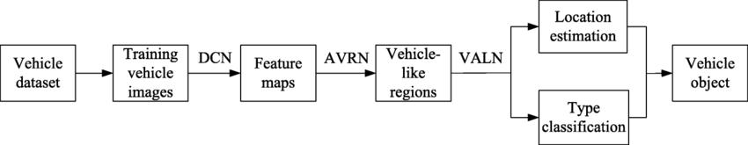
Architecture diagram

Slide 13
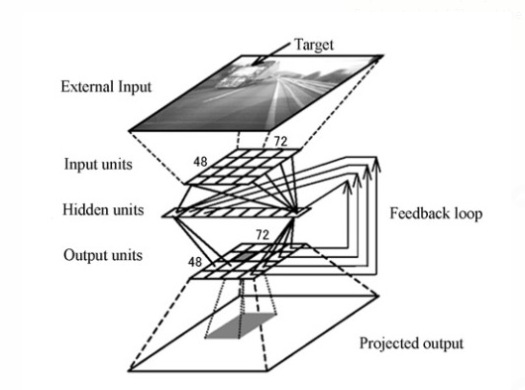
Architecture diagram

Slide 14
BLOCK DIAGRAM
Input data acquisition system (video)
Preprocessing
Feature extraction
segmentation

Slide 15
PROPOSED SYSTEM
The Convolutional Neural Network (CNN) is a type of neural network that is frequently used for object recognition and image analysis.
For supervised learning for binary classifiers .This means that the functions can decide whether an Input which is represented by a vector of numbers belong to some specific class or not.

Slide 16
Proposed Modules and their algorithm description
Input: We should input the videos from traffic cameras.
Image Processing: Image Processing is a technique to enhance raw images received from cameras/sensors placed on satellites, space probes, and aircraft or pictures taken in normal day-to-day life for various applications.Various techniques have been developed in Image Processing during the last four to five decades. Most of the techniques are developed for enhancing images obtained from unmanned spacecraft, space probes, and military reconnaissance flights. Image Processing systems are becoming popular due to the easy availability of powerful personnel. computers, large-size graphics software, etc. Image Processing is used in various Techniques.
Preprocessing: Pre-processing is a common name for operations with images at the lowest level of abstraction of both input and output are intensity images. The aim of pre-processing is an improvement of the image data that suppresses unwanted distortion.

Slide 17
Some of the point processing techniques include contrast stretching, global thresholding, histogram equalization, log transformations, and power law transformations. Some mask-processing techniques include averaging filters, sharpening filters, local thresholding… etc.
Different techniques:
1. Data preprocessing is a data mining technique that involves transforming raw data into an understandable format. Data preprocessing is a proven method of resolving such issues. Data preprocessing prepares raw data for further processing. Or enhances some image features important for further processing.
2. Feature extraction is a part of the dimensionality reduction process, in which, an initial set of raw data is divided and reduced into more manageable groups. ... These features are easy to process, but still able to describe the actual data set with accuracy and originality. Feature Extraction uses an object-based approach to classify imagery, where an object (also called a segment) is a group of pixels with similar spectral, spatial, and/or texture attributes. Traditional classification methods are pixel-based, meaning that spectral information in each pixel is used to classify imagery.

Slide 18
Edge detection is the process of locating edges in an image which is a very important step toward understanding image features. It is believed that edges consist of meaningful features and contain significant information. It significantly reduces the size of the image that will be processed and filters out information that may be regarded as less relevant, preserving and focusing solely on the important structural properties of an image for a business problem.
Edge-based segmentation algorithms work to detect edges in an image, based on various discontinuities in grey level, color, texture, brightness, saturation, contrast, etc. To further enhance the results, supplementary processing steps must follow to concatenate all the edges into edge chains that correspond better with the borders in the image.
Edge detection algorithms fall primarily into two categories – Gradient-based methods and Gray Histograms. Basic edge detection operators like sobel operator, canny, Robert’s variable, etc are used in these algorithms. These operators aid in detecting the edge discontinuities and hence mark the edge boundaries. The end goal is to reach at least a partial segmentation using this process, where we group all the local edges into a new binary image where only edge chains that match the required existing objects or image parts are present.

Slide 19
Image Segmentation is the process by which a digital image is partitioned into various subgroups (of pixels) called Image Objects, which can reduce the complexity of the image, and thus analyzing the image becomes simpler. We use various image segmentation algorithms to split and group a certain set of pixels from the image. By doing so, we are assigning labels to pixels and the pixels with the same label fall under a category where they have some or the other thing common in them. Using these labels, we can specify boundaries, draw lines, and separate the most required objects in an image from the rest of the not-so-important ones. In the below example, from the main image on the left, we try to get the major components, e.g. chair, table, etc. and hence all the chairs are colored uniformly. In the next tab, we have detected instances, which talk about individual objects, and hence all the chairs have different colors.

Slide 20
SVM
SVMs, on the other hand, are a type of supervised learning algorithm used for classification tasks. They are particularly effective when the dataset is small and the number of features is limited. SVMs are often used to classify vehicles based on their attributes such as make and model.
Support Vector Machines (SVMs) are commonly used for classification tasks and have been shown to be highly effective in identifying vehicles based on their attributes such as make and model. They are particularly useful when the dataset is small and the number of features is limited.

Slide 21
CNN
CNN, or Convolutional Neural Network, is a deep learning algorithm used for image processing and computer vision tasks. It consists of multiple layers, including convolutional, pooling, and fully connected layers.
Convolutional Neural Networks (CNNs) are commonly used for image classification tasks and have been shown to be highly efficient in identifying vehicles from images. They can automatically learn relevant features from images, which makes them highly effective in detecting and classifying vehicles.
CNNs are typically used for image classification tasks, making them well-suited for identifying vehicles from images. They can automatically learn relevant features from images and use them to classify the vehicles based on their make and model, license plate number, or other attributes.

Slide 22
RNN AND LSTM
RNNs, on the other hand, are used for sequential data such as video frames or sensor data, making them ideal for tracking vehicles over time and predicting their future positions. They can capture temporal dependencies in the data and use them to predict the next frame in a video or the future location of a vehicle.
LSTM networks are a type of RNN that are particularly effective in handling long-term dependencies in sequential data. They can learn and remember patterns over long periods of time, making them well-suited for vehicle tracking tasks
Recurrent Neural Networks (RNNs) and Long Short-Term Memory (LSTM) networks are well-suited for sequential data such as video frames or sensor data. They can capture the temporal dependencies in the data, making them highly effective in tracking vehicles over time and predicting their future positions.

Slide 23
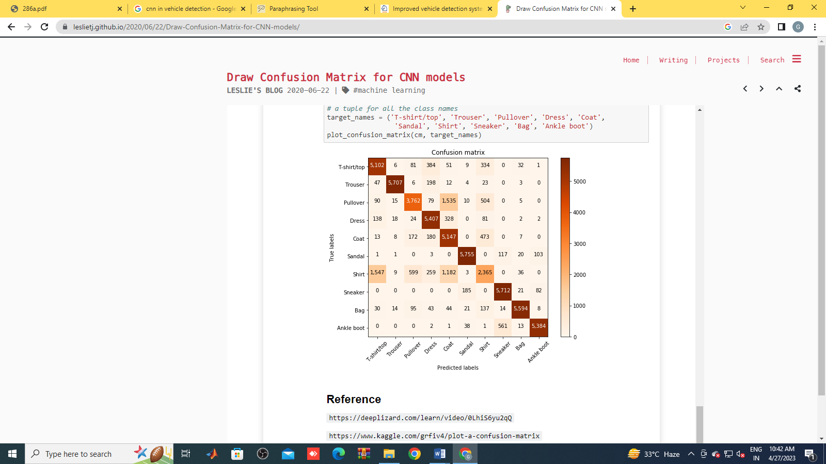
Confusion matrix for CNN

Slide 24
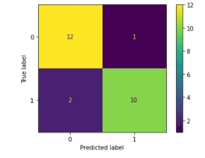
Confusion matrix for SVM

Slide 25
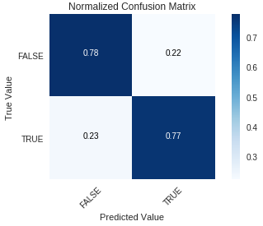
Confusion matrix for LSTM

Slide 26
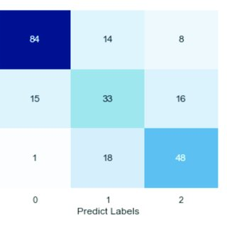
Confusion matrix for RNN

Slide 27
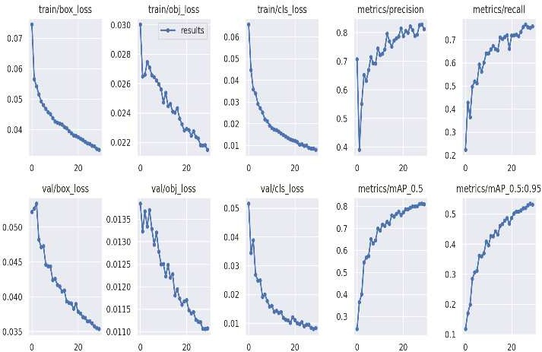
Various performance metric curves

Slide 28
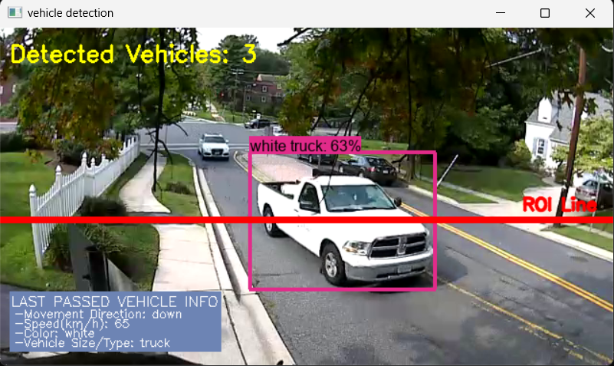
Output image: CNN

Slide 29
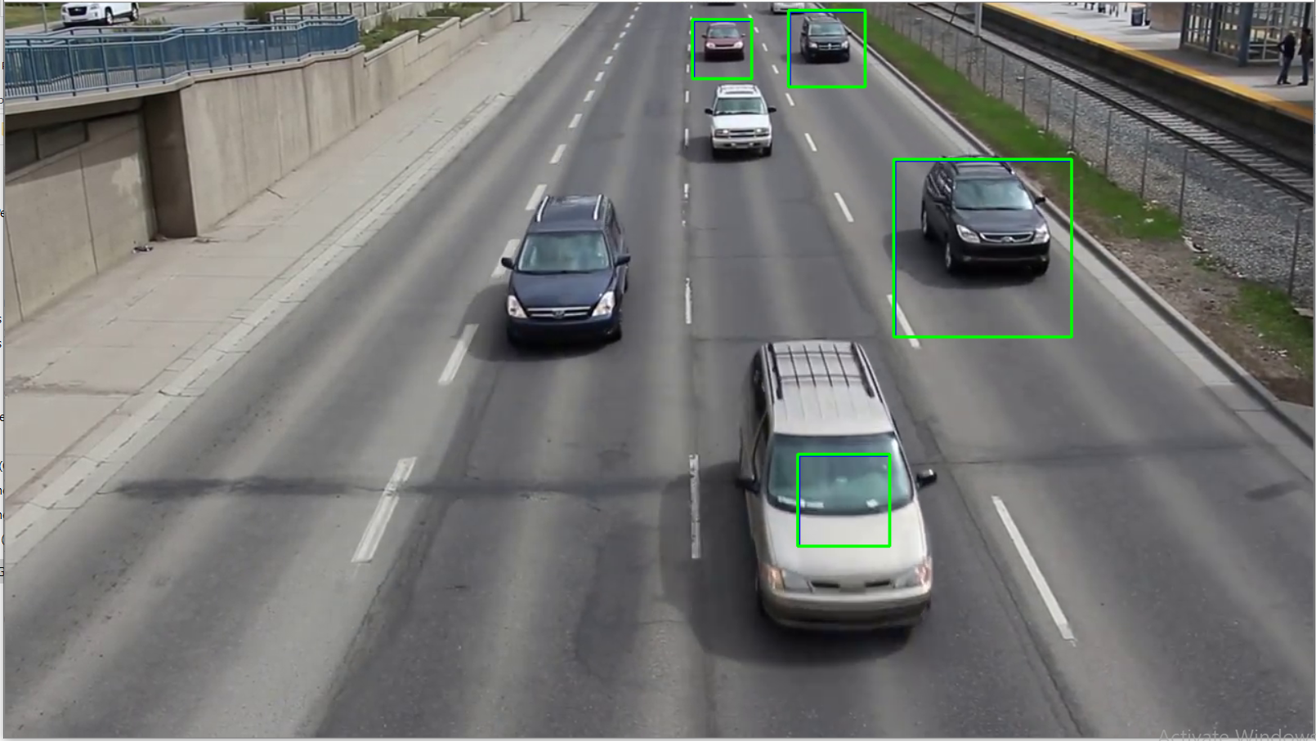
Output image: RNN and LSTM

Slide 30
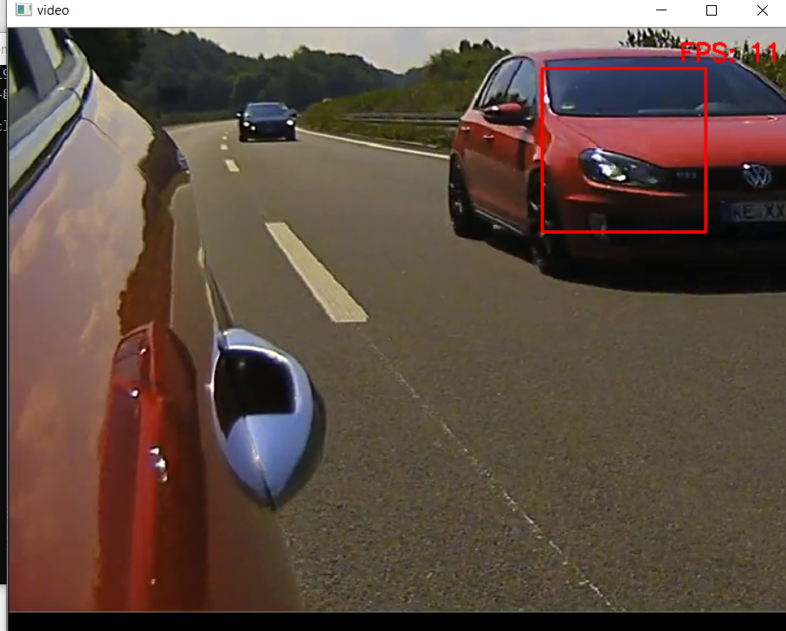
Output image: SVM

Slide 31
CONCLUSION
In conclusion, CNNs are most commonly used for automated vehicle identification tasks due to their ability to extract features automatically from images. RNNs and LSTMs are well-suited for tasks that involve sequential data, such as tracking the movement of vehicles. SVMs can also be used for classification tasks, but they may not be as effective as CNNs for image-based tasks. The choice of algorithm ultimately depends on the specific requirements of the project and the nature of the data being analyzed. Overall, deep learning models such as CNNs and RNNs have shown to be highly effective in automated vehicle identification tasks, and are likely to be a key component in the development of future intelligent transportation systems.

Slide 32
References
A. Gregoriades, C. Florides, V. P. Lesta, and M. Pampaka, “Driver behaviour analysis through simulation,” in IEEE International Conference on Systems, Man, and Cybernetics, pp. 3681-3686, 2013.
Z. Guo, Y. Pan, G. Zhao, S. Cao, and J. Zhang, “Detection of driver vigilance level using EEG signals and driving contexts,” in IEEE Transactions on Reliability, vol. 1, pp. 370-380, 2018.
T. A. Ranney, E. Mazzae, R. Garrott, and M. J. Goodman, "NHTSA driver distraction research: Past, present, and future," in Driver Distraction Internet Forum, pp. 1-11, 2000.
V. P. Kumar, K. Rajesh, M. Ganesh, I. R. P. Kumar, and S. Dubey, "Overspeeding and rash driving vehicle detection system,” in Texas Instruments India Educators' Conference (TIIEC), vol. 18, pp. 25-28, 2014.
W. Z. Musa, J. Prasetijo, and Z. F. Zainal, "Road fatality model based on over-dispersion data along federal route F0050," in MATEC Web of Conferences, vol. 103, p. 08012, 2017.
O. Kumtepe, G. B. Akar, and E. Yuncu, “Driver aggressiveness detection using visual information from forward camera,” in 12th IEEE International Conference on Advanced Video and Signal Based Surveillance (AVSS), pp. 1-6, 2015.
C. Saiprasert, S. Thajchayapong, T. Pholprasit, and C. Tanprasert, “Driver behaviour profiling using smartphone sensory data in a V2I enironment,” in IEEE International Conference on Connected Vehicles and Expo (ICCVE), pp. 552-557, 2014.
A. Kelly, O. Amidi, M. Bode, M. Happold, H. Herman, T. Pilarski, P. Rander, A. Stentz, N. Vallidis, and R. Warner, “Toward reliable off road autonomous vehicles operating in challenging environments,” in Springer Tracts Adv. Robot in The International Journal of Robotics Research 25, no. 5-6, pp 449-483, 2006.
M. H. Alsibai and S. A. Manap,"A study on driver fatigue notification systems, " in ARPN Journal of Engineering and Applied Sciences, vol. 11, pp. 10987- 10992, 2016.
A. Sahayadhas, K. Sundaraj, and M. Murugappan, "Detecting driver drowsiness based on sensors: A review," in Journal of Physical Sensors, vol. 12, pp. 16937-16953, 2012

